Slide 1
Turn 2D Video into 3D Motion Sculpture
WANG, ZHENG

Slide 2
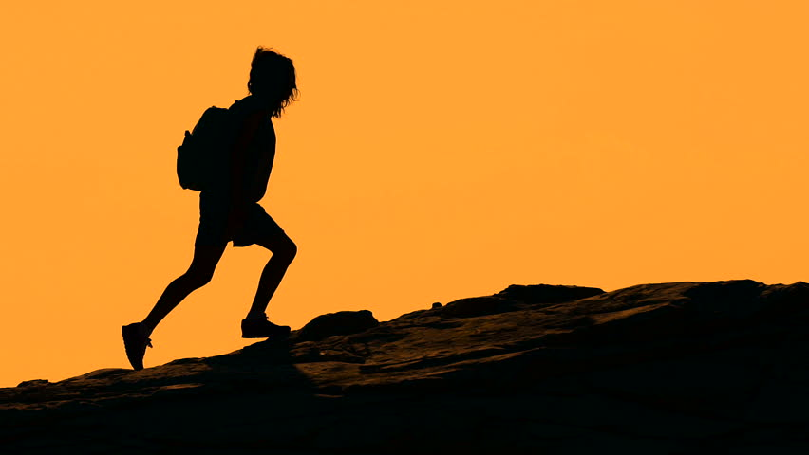
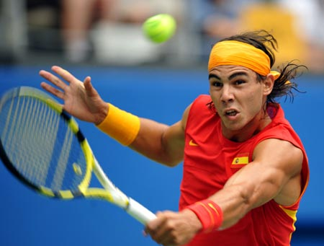
Interpreting Motion
Learning the a particular movement precisely is important for all organism
For human, a widely used source is video recordings
But it is hard to find out the exact details of a motion from the video by naked eye
Video is a two dimensional, but the motion happens in 3D space
Things happens too fast and it is hard to capture by eye

Slide 3
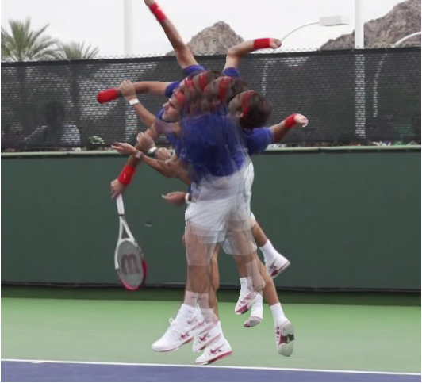
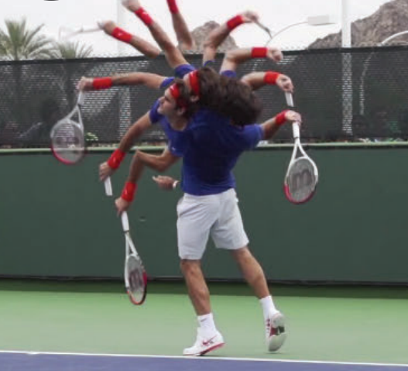
Conventional Way of Interpreting Motion
stroboscopic photography
Image from selected frames are overlapped
Hard to see the actual motion
shape-time photography
Slight rendering to display clearer image
But there are noticeable artifacts

Slide 4
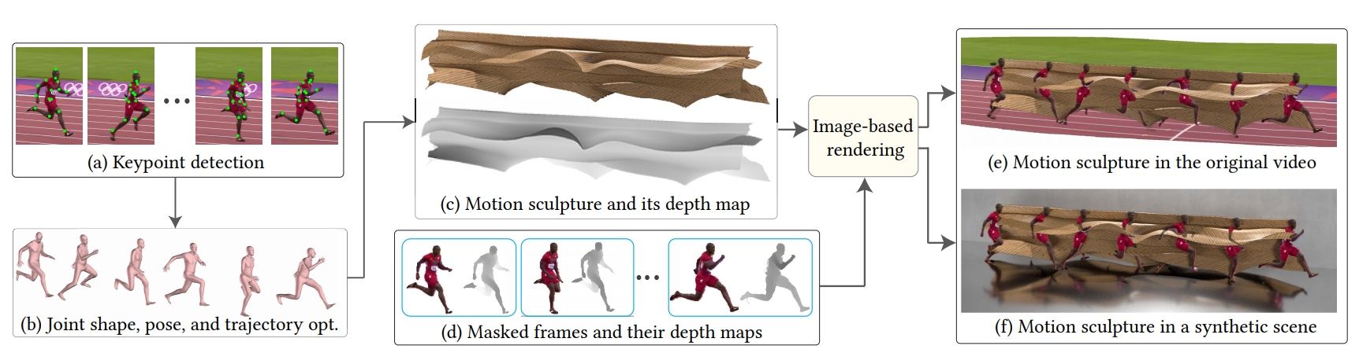
The MoSculp Approach
Workflow:
2D key points detection
Use the 2D key points to reconstruct the 3D model over time
Generating 3D sculpture
Rendering the sculpture back to the video and refinement

Slide 5
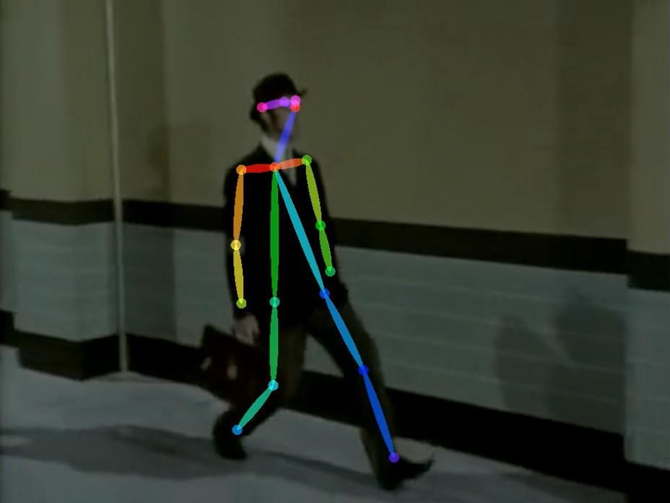
Key Point Detection
Key points are placed at joints of the body
To trace the pose of the body during the movement
The 2-D coordinate of each frame of each key point is recorded
To construct the time related “function” that describes pose changes
OpenPose is used for automatically detecting the key points

Slide 6
Key Point Detection - Issues & Solutions
Inaccuracy of OpenPose model due to motion
When left and right side flip during the motion
Blur image due to fast motion
Solution
Check temporal coherency
Hidden Markov Model to check the smoothness of the motion

Slide 7
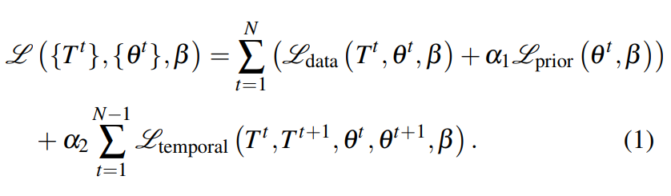
3D Model Reconstruction
The idea is to find 3D model for each fram whose key point projection to the 2D plane is close to the key points marked in last step
An extension of the SMPL body model is used in this step
Three things to minimize:
Projection error (data part)
Impossible poses (prior part)
Disruptive motion (temporal part)
Summarize as the cost function.

Slide 8
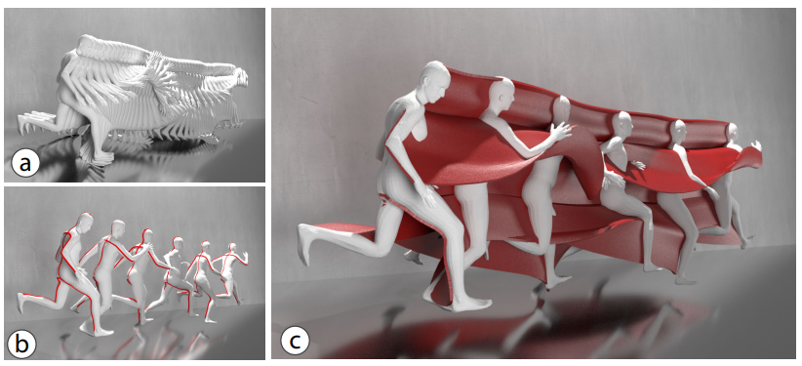
Generating Sculpture
Relatively easy when the 3D body model has been constructed.
The software extracts the surface skeleton from each frame
Trace the skeleton of one’s body and join them frame by frame to produce the sculpture.
The depth information of the sculpture is stored for later use of rendering.

Slide 9
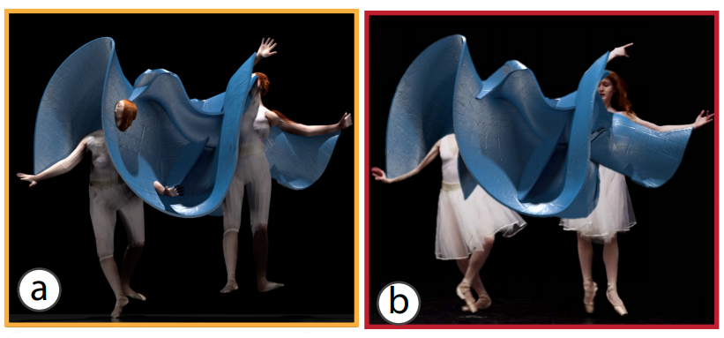
Rendering Back to the Video
Simply imposing the sculpture causes losses in the information of the video
Need to estimate the depth of the person on each frame of the video
Render the sculpture to the video according to the depth map of the video

Slide 10
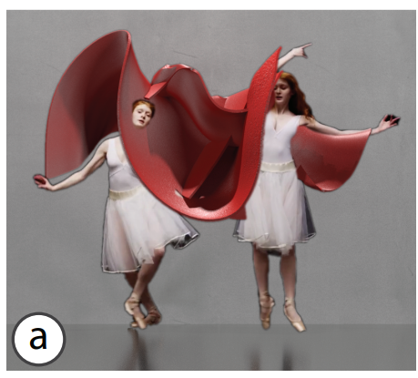
Refinement
Not as easy as what we described before
The estimation is not entirely accurate
Depth of the sculpture is slightly inconsistent with the video depth map.
The result is visible artifacts on the rendering

Slide 11
Refinement - idea explained
Take the 2D projection of the sculpture in each frame
Adjust the x-y coordinate of the projection on each frame
To compensate the distortion introduced by the x-y coordinate adjustment, smooth each dimension with a Gaussian kernel.

Slide 12
Applications
In field that requires studies of motion (e.g. athletics, dance)
In artistic tools that allow users extensively customize the aesthetics of their renderings, while keep the rendering understandable
Rendering motion sculptures in other media (such as 3D printed sculptures)

Slide 13
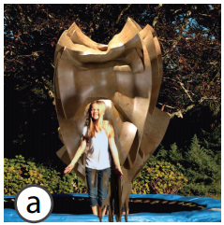
Some Existing Problems
Does not work so well when the person’s position is relatively static in the picture
Sometimes produce small errors in the 3D model due to information loss in projection

Slide 14
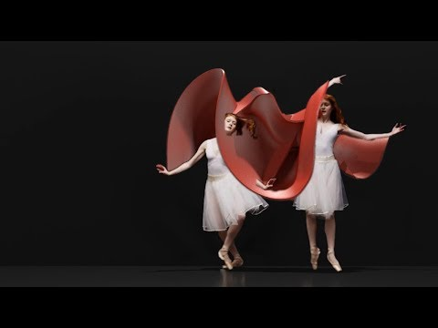

Slide 15
Reference
Xiuming Zhang, Tali Dekel, Tianfan Xue, Andrew Owens, Qiurui He, Jiajun Wu, Stefanie Mueller, William T. Freeman, ACM Symposium on User Interface Software and Technology (UIST) 2018, MoSculp: Interactive Visualization of Shape and Time
http://mosculp.csail.mit.edu/assets/paper.pdf
Creating 3-D-printed “motion sculptures” from 2-D videos, MIT News, September 18, 2018
https://news.mit.edu/2018/creating-3-d-printed-motion-sculptures-from-2-d-videos-mit-csail-0919

Slide 16
Thank You
For
Listening

